Slide 1


Exploring the Fascinating World of Terrorism Data
Project 1 Team 5
Krishna Mistry Mahind Rao Rachel Schoen
Nicole Rennie

Slide 2





Introduction:
Brief overview of the analysis objectives
Importance of data-driven insights in understanding terrorism
Outline of the key areas covered in the analysis

Slide 3

Q1: To develop effective methodologies for measuring terrorism within each country, encompassing incident frequency, casualty rates, and threat levels

Slide 4
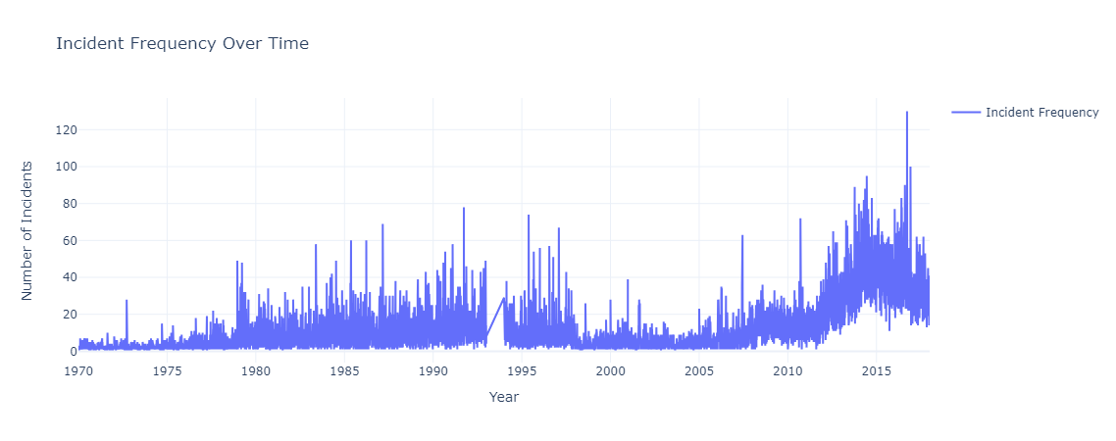
Overall Trend
Significant increase in incident frequency over time, particularly after the early 2010s.
Fluctuations in incident frequency suggest varying levels of terrorist activity.
Key Periods
1970s: Begins with relatively low incident frequency but sees a gradual increase throughout the decade.
1980s-1990s: Continues to rise, with intermittent spikes and dips in activity.
Post-2000: Notable surge in terrorist incidents, with multiple peaks indicating heightened activity.

Slide 5
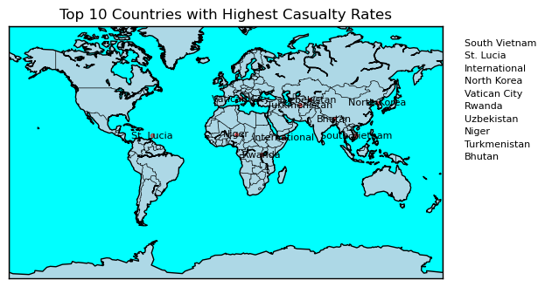
Key Analysis
The top 10 countries with the highest casualty rates paint a diverse picture of regions affected by terrorism.
From South Vietnam to North Korea, and from Vatican City to Rwanda, each nation faces unique challenges in combating terrorism and mitigating its impact on civilian populations.
While some countries may grapple with longstanding conflicts and insurgencies, others may experience sporadic terrorist incidents that nonetheless have significant consequences.

Slide 6


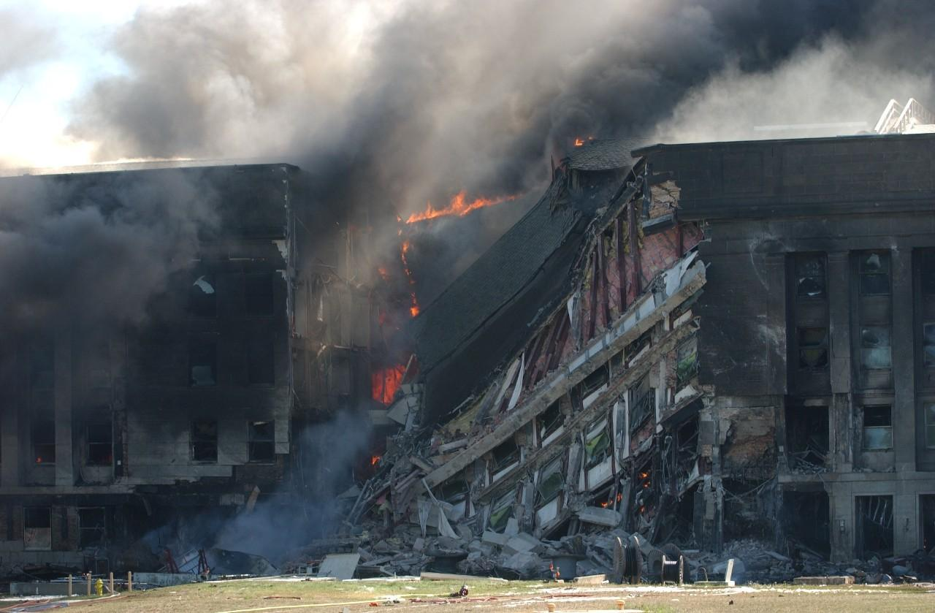
Q2: To identify countries with the highest and lowest rates of terrorism and elucidate factors contributing to these variations

Slide 7
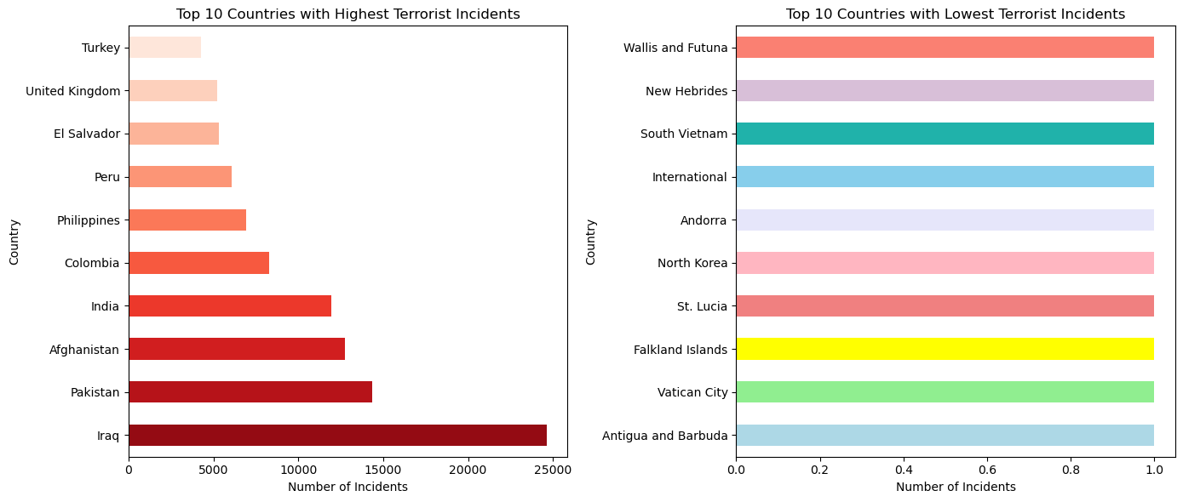
Identify countries with highest and lowest terrorism rates
Key Insights
The country with the highest number of terrorist attacks is Iraq.
The country with the lowest number of terrorist attacks is Antigua and Barbuda.

Slide 8
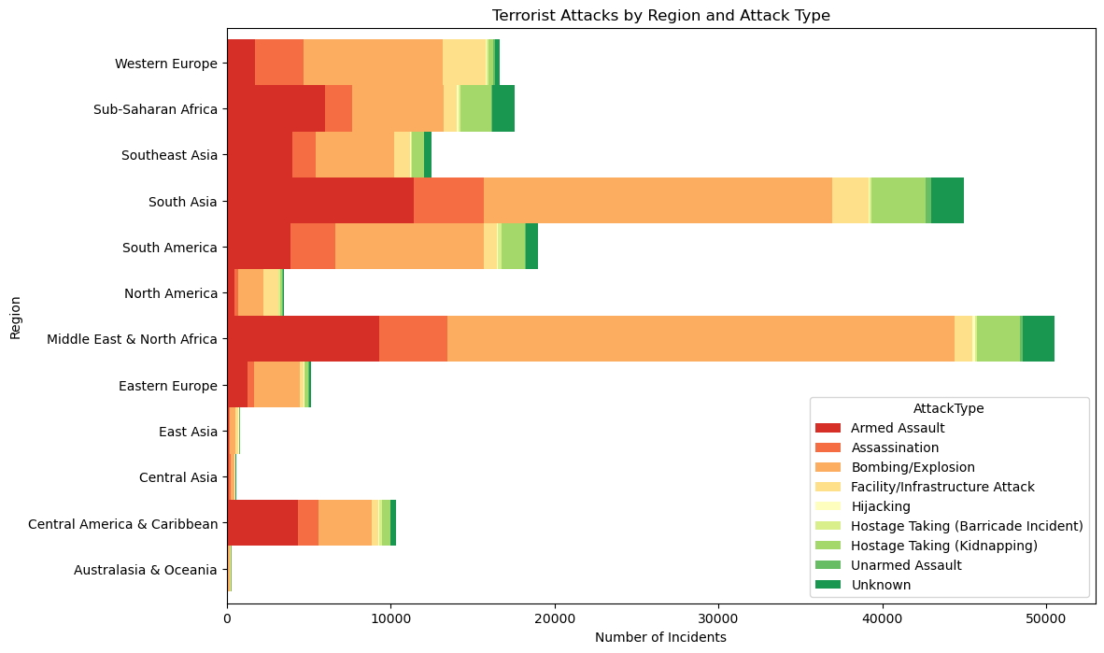
Identify regions with highest and lowest terrorism rates
Key Insights
The regions with the highest number of terrorist attacks are the Middle East and North Africa.
The regions with the lowest number of terrorist attacks are the Australasia and Oceania.

Slide 9



Q3: To uncover a pattern or a common characteristic in countries that would contribute to the rate of terrorism

Slide 10
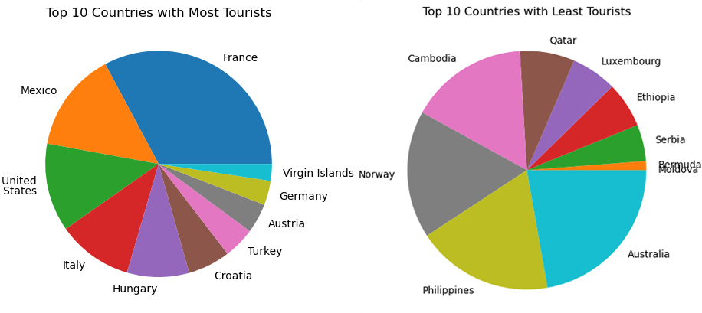
Identify countries with highest and lowest tourism rates (by number of tourists).
Key Insights
Highest number of tourists is France at 117.1 million.
Lowest number of tourists is Moldova at less than 1 million (unspecified).
Generally, most tourists go to North America or Western Europe, and tend to not go to the Middle East or Eastern Europe.

Slide 11
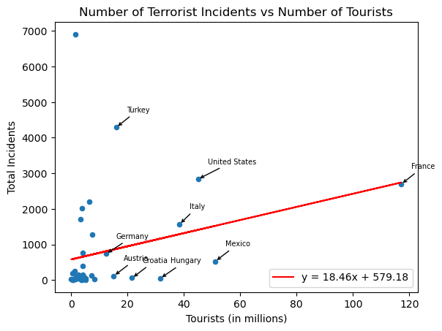
Compare the number of tourists to the number of terrorist incidents
Key Insights
Correlation coefficient: 0.28
These findings indicate that, generally speaking, terrorists do not appear to specifically target tourists, but further research would be needed to definitively conclude which variables terrorists do target.
This indicates a weak, but positive, correlation.
In broad terms, this means there is little evidence that the more tourists a country has, the more likely it will be have incidents of terrorism.

Slide 12



Q4: Investigation on whether certain countries exhibit dominance in specific types of terrorist activities, and explore underlying explanatory factors

Slide 13
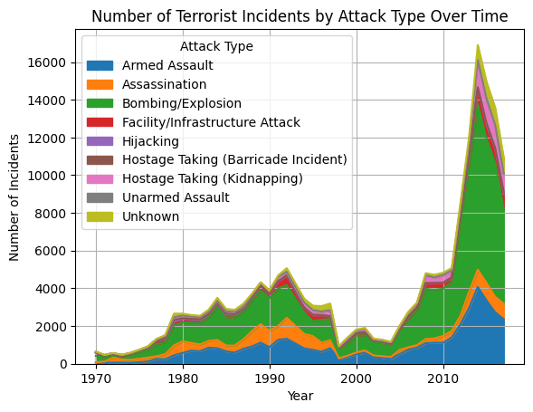
Type of Terrorist attacks over time
Key Insights
The findings highlight the diverse methods employed by terrorists.
Bombing/explosion, armed assault, and assassination standing out as prominent tactics.
Understanding these patterns is crucial for devising effective counter-terrorism strategies aimed at mitigating the impact of such attacks on societies worldwide.

Slide 14
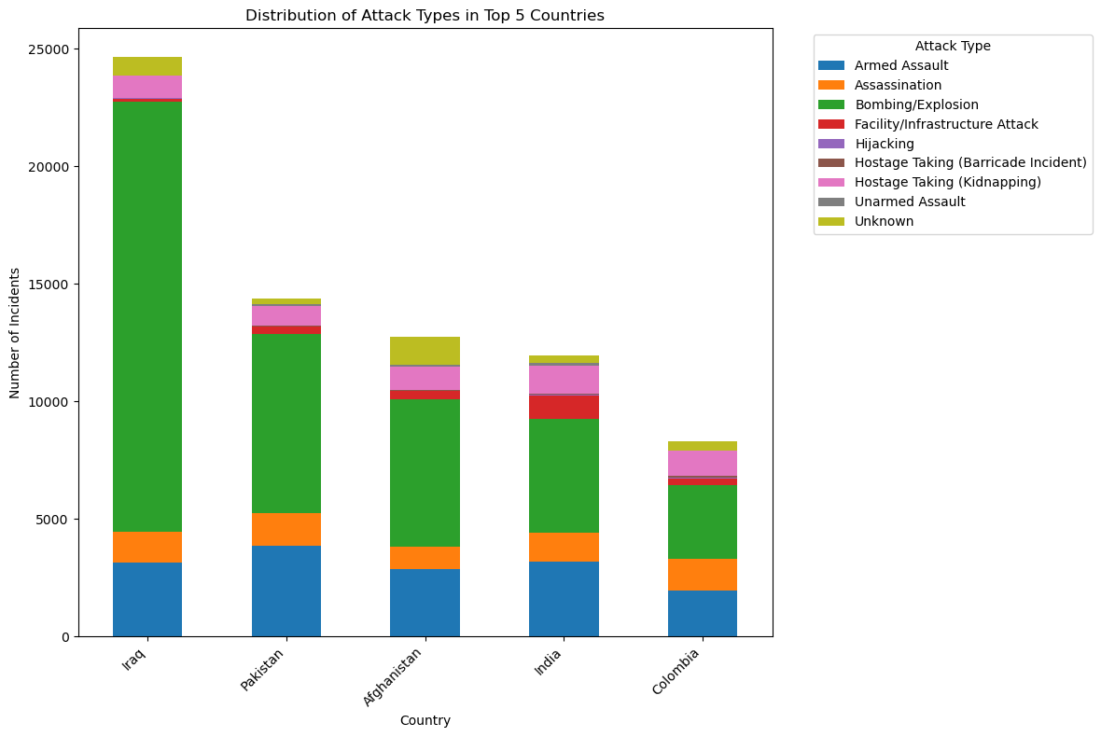
Type of Terrorist Attacks in the Top Five highest Terrorist Attack Rate Countries
Key Insights
The analysis reveals that Iraq, Pakistan, Afghanistan, India, and Colombia emerge as the top five countries experiencing the highest frequency of terrorist attacks.
The top attack type in all 5 countries is bombing/explosion.

Slide 15
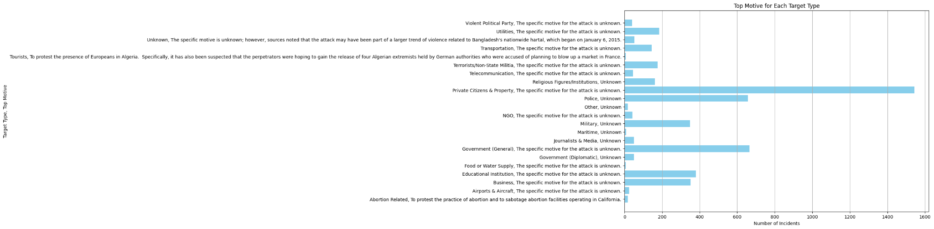
Attacks in Relation to Motive
Key Insights
The analysis reveals diverse motives behind terrorist incidents targeting various types of entities.
For target types such as 'Abortion Related' and 'Tourists', specific motives are apparent. In the case of 'Abortion Related' incidents, the primary motive appears to be to protest the practice of abortion and sabotage abortion facilities, particularly in California. On the other hand, attacks targeting 'Tourists' seem motivated by protesting the presence of Europeans in Algeria, coupled with a suspected aim to secure the release of Algerian extremists held by German authorities.
However, for many other target types, the motive remains unknown or unspecified.

Slide 16
Limitations
The dataset had a lot of entries that were “unknown”, leading to gaps in the analysis. Additionally, the accuracy and reliability of the data might be questionable, as most terrorist incidents cannot be identified with a motive. While the analysis aims to explore underlying explanatory factors, the dataset’s limitations make it challenging to establish causal relationships between variables. Correlation does not imply causation, and additional contextual information may be needed to infer more accurately.

Slide 17
Lessons Learned and the Path Forward
Key Insights
Implications for Policymakers
Recommendations for Action
- Steady increase in terrorist incident frequency over time
-Distinct seasonal patterns and geographical hotspots
-Disproportionately high casualty rates in certain regions
-Uneven distribution of terrorist groups across countries
-Partial impact of terrorism on the tourism industry
- Prioritize resource allocation and develop targeted strategies
- Enhance international cooperation and information-sharing
- Address root causes and underlying drivers of terrorism
- Strengthen resilience and protection of critical infrastructure
- Support affected communities and provide aid to victims
- Invest in advanced data analysis and predictive capabilities
- Foster cross-border collaboration and intelligence exchange
- Implement comprehensive counterterrorism policies
- Develop robust crisis management and response protocols
- Promote economic development and social inclusion initiatives

Slide 18
Thank You
Any Questions?

